Slide 1
<state> Maternal Mortality Review Committee Member Orientation

Slide 2
Objectives
Review and define key terms
Provide an overview of the maternal mortality review history and data
Discuss the authorities and protections in place for maternal death review
Understand the Maternal Mortality Review Committee (MMRC) process
Provide an overview of Maternal Mortality Review Information Application (MMRIA)
Review the MMRC roles and member responsibilities
Discuss the MMRC Timeline/First Meeting/Next Steps
Notes:
Instructions to program:
Review the objectives of the day with the committee members, update as needed to cover key topics in your specific orientation event.

Slide 3
Key Definitions

Slide 4
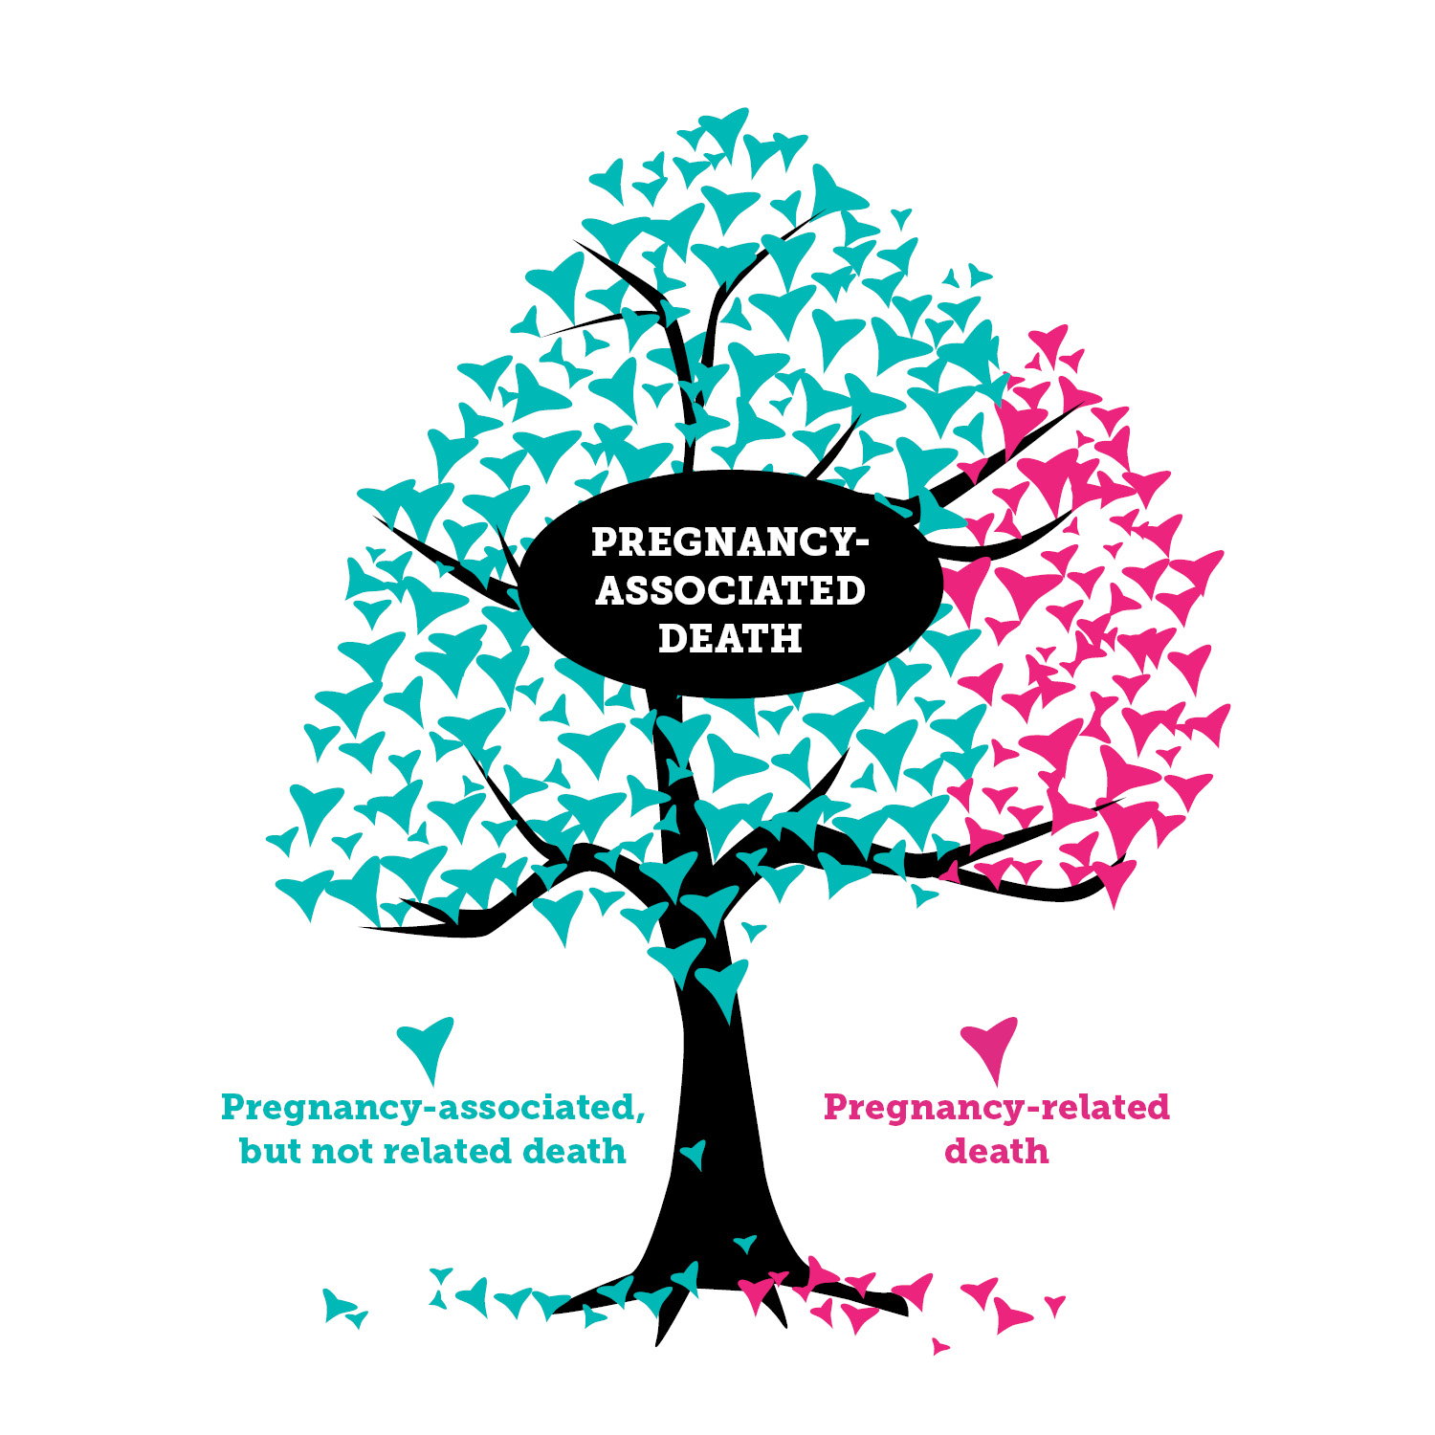
  Pregnancy-associated death:
    A death during or within one year of pregnancy irrespective of cause.
Pregnancy-related death:
  A death while pregnant or within one year of the end of pregnancy from a pregnancy complication, a chain of events initiated by pregnancy, or the aggravation of an unrelated condition by the physiologic effects of pregnancy.
Pregnancy-associated but NOT related death:
  A death during or within on year of the end of pregnancy from a cause that is not related to pregnancy.
Sourced from: MMRIA Facilitation Guide and Review to Action https://reviewtoaction.org/content/mmria-committee-facilitation-guide
Graphic sourced from: South Dakota Department of Health https://doh.sd.gov/statistics/maternalmortality.aspx
Notes:
Instructions to program:
Discuss the differences between pregnancy-associated death and pregnancy-related death. For pregnancy-related death, it is important to emphasize “if she had not been pregnant would she have died?”

Slide 5
Maternal Mortality Review History and Data
(enter corresponding slides, as appropriate)

Slide 6
Every Maternal Death is a Tragedy
700
Each year in the U.S., about 700 women die as a result of pregnancy complications
Sourced from: https://www.cdc.gov/reproductivehealth/maternal-mortality/pregnancy-mortality-surveillance-system.htm
Notes:
Possible script for slide:
Each year in the U.S., about 700 women die from pregnancy complications. This data comes from the CDC’s Pregnancy Mortality Surveillance System. It is the most accurate source of national data on pregnancy-related deaths.
All of these women are dying during a period when they should have a lot of support; in health care and in their communities.

Slide 7
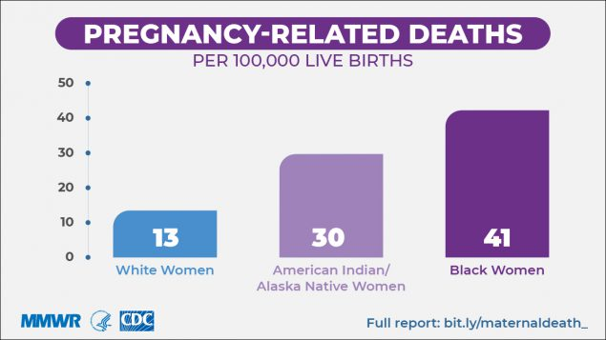
Native American/Alaska Native and Black Women are 2 – 3 Times More Likely to Die of Pregnancy-Related Causes than White Women
Sourced from: https://www.cdc.gov/reproductivehealth/maternal-mortality/pregnancy-mortality-surveillance-system.htm, and
Petersen, EE et al. Racial/Ethnic Disparities in Pregnancy-Related Deaths-United States, 2007 - 2016
Notes:
There are considerable racial disparities in maternal deaths. When we use the term disparity it indicates an unjust difference.
Black and Native women were 2 to 3 times more likely to die of pregnancy-related causes than white women.

Slide 8
Pregnancy-Related Mortality, PMSS, 1999-2017: Not Improving
Sourced from: https://www.cdc.gov/reproductivehealth/maternal-mortality/pregnancy-mortality-surveillance-system.htm
Notes:
Possible script for slide:
PMSS is the most accurate source of national data on pregnancy-related mortality.
We have seen not seen improvements in the pregnancy-related maternal mortality ratio for a decade, despite technology and other advancements in medical care.

Slide 9
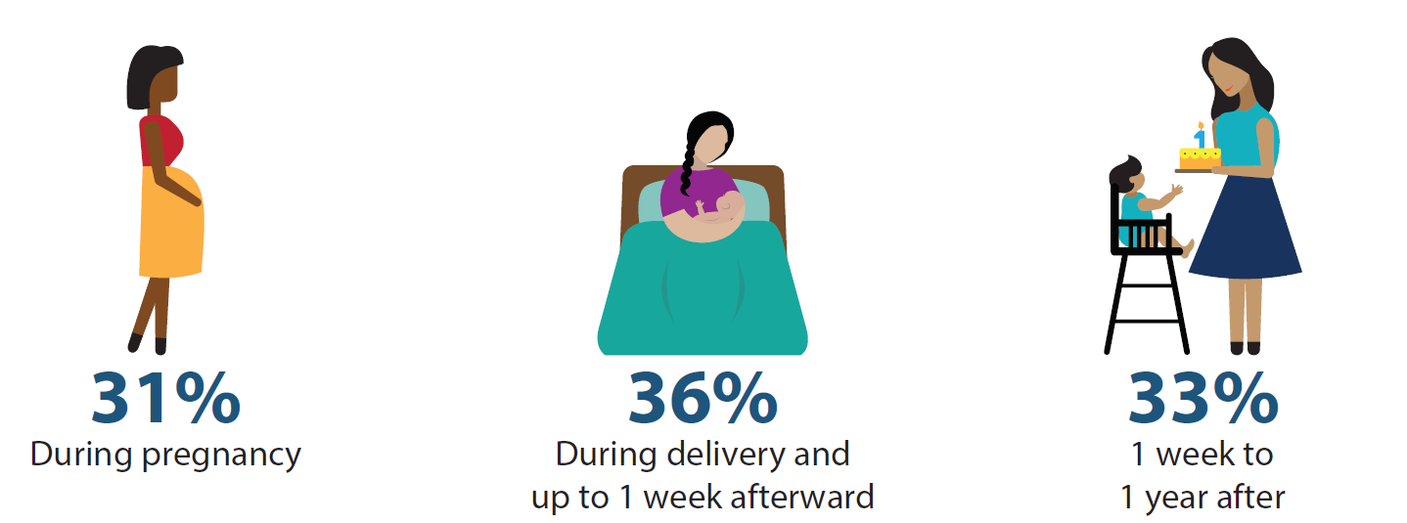
Pregnancy-Related Deaths
Occur Up to a Year from the End of Pregnancy
Sourced from: https://www.cdc.gov/mmwr/volumes/68/wr/mm6835a3.htm?s_cid=mm6835a3_w
Notes:
Instructions to program:
Discuss information on the slide.
Consider including a few additional slides highlighting recent national data, sources may include:
CDC PMSS data, available at:
https://www.cdc.gov/reproductivehealth/maternal-mortality/pregnancy-mortality-surveillance-system.htm
Recent CDC MMWRs or Vital signs with pregnancy-related death analyses
Racial/Ethnic Disparities in Pregnancy-Related Deaths — United States, 2007–2016; available at: https://www.cdc.gov/mmwr/volumes/68/wr/mm6835a3.htm?s_cid=mm6835a3_w
Pregnancy-Related Deaths, United States, 2011–2015, and Strategies for Prevention, 13 States, 2013–2017; available at: https://www.cdc.gov/mmwr/volumes/68/wr/mm6818e1.htm

Slide 10
Data From 14 MMRCs (2008-2017)
Approximately 1 in 3 deaths among women during or within a year of pregnancy were pregnancy-related.
Leading causes of pregnancy-related deaths varied by race/ethnicity.
2 out of 3 deaths were determined to be preventable.
Sourced from: Davis, NL., Smoots AN., Goodman DA. Pregnancy-Related Deaths: Data from 14 U.S. Maternal Mortality Review Committees, 2008-2017
https://www.cdc.gov/reproductivehealth/maternal-mortality/erase-mm/mmr-data-brief.html
Notes:
Instructions to program:
MMRCs are the most accurate source for state data.
Add other data points as relevant:
CDC’s 14 state brief: Pregnancy-Related Deaths: Data from 14 US Maternal Mortality Review Committees, 2008–2017 is a data brief released by CDC with updated data from 14 MMRCs.

Slide 11
<state>-specific Data
Enter corresponding slides from recent analyses and reports, see notes for further consideration on state-specific data to present, as relevant
Notes:
Instructions to program:
Review recent, jurisdiction-specific data from PMSS or MMRC (information from death certificates alone, e.g. maternal mortality rates from NCHS or CDC WONDER, should only be presented if PMSS or MMRC numbers are not available. If choosing to present death certificate data alone, consider including: death certificate data alone is very limited, and in some states has severe data quality issues.)
May consider including:
Distribution of deaths by timing (pregnancy related and/or associated), i.e. pregnant at time of death, within 42 days, 43-1 year, not specified.
Proportion of pregnancy-associated determined to be pregnancy-related (by age, race/ethnicity, other disaggregates as relevant)
Pregnancy-Related Mortality Ratio (PRMR) (by age, race/ethnicity, location, other disaggregates where relevant)
Causes of pregnancy-related deaths, including leading underlying causes
Other data to highlight relevant disparities in pregnancy-related mortality (by race/ethnicity)
Any data on contributing factors and recommendations, or data to action that is context specific

Slide 12
Impact
Deaths
Near Misses
Severe Maternal Morbidity
Maternal Morbidity Requiring Hospitalization
Maternal Morbidity Resulting in Emergency Department Visit
Maternal Morbidity Resulting in Primary Care Visit
Sourced from: Building U.S. Capacity to Review and Prevent Maternal Deaths. (2018). Report from nine maternal mortality review committees.
http://reviewtoaction.org/Report_from_Nine_MMRCs
Notes:
Instructions to program:
Discuss how maternal deaths relate to broader goals to prevent maternal morbidity.
Possible script for slide:
Maternal deaths are only the most extreme of bad outcomes. They are the tip of the iceberg.
There are approximately 50,000 severe maternal morbidities that occur each year in the U.S. and far greater numbers of women who experience less severe complications of pregnancy…..
CLICK (next slide continues the pyramid)

Slide 13
Impact
Cascading Effects of Review Committee Actions
Eliminate preventable maternal deaths
Improve population health of women
Reduce maternal morbidity
Deaths
Near Misses
Severe Maternal Morbidity
Maternal Morbidity Requiring Hospitalization
Maternal Morbidity Resulting in Emergency Department Visit
Maternal Morbidity Resulting in Primary Care Visit
Sourced from: Building U.S. Capacity to Review and Prevent Maternal Deaths. (2018). Report from nine maternal mortality review committees. http://reviewtoaction.org/Report_from_Nine_MMRCs
Notes:
Instructions to program:
Discuss how maternal deaths relate to broader goals to prevent maternal morbidity.
Possible script for slide:
We believe that by comprehensively reviewing every death, making recommendations for action, and acting on those recommendations, the work of maternal mortality review committees can:
eliminate preventable maternal deaths, but also….
reduce maternal morbidities, and improve population health of women of reproductive age.

Slide 14
Authorities and Protections
(enter corresponding slides, as appropriate)

Slide 15
Authorities and Protections
The maternal mortality review is conducted pursuant to [§______] and Department of Public Health rules and regulations pertaining to the reporting of selected causes of mortality in <state>. The Department may have access to medical records of fatalities that occur in association with pregnancy or for up to one year from the end of pregnancy.
Notes:
Instructions to program:
Reference statute/Authorizing legislation

Slide 16
Overview of the Review Committee Process

Slide 17
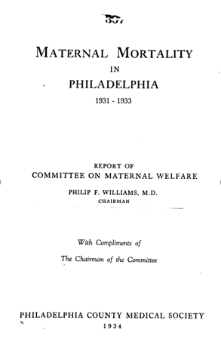
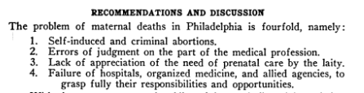
MMRCs: Not new

Slide 18
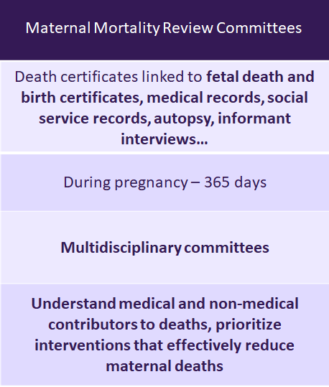
The Role of the MMRC
CDC – National Center for Health Statistics (NCHS) | CDC – Pregnancy Mortality Surveillance System (PMSS) | Maternal Mortality Review Committees
Data Source | Death certificates | Death certificates linked to fetal death and birth certificates | Death certificates linked to fetal death and birth certificates, medical records, social service records, autopsy, informant interviews…
Time Frame | During pregnancy – 42 days | During pregnancy – 365 days | During pregnancy – 365 days
Source of Classification | ICD-10 codes | Medical epidemiologists (PMSS-MM) | Multidisciplinary committees
Purpose | Show national trends and provide a basis for international comparison | Analyze clinical factors associated with deaths, publish information that may lead to prevention strategies | Understand medical and non-medical contributors to deaths, prioritize interventions that effectively reduce maternal deaths
Sourced from: St Pierre A, Zaharatos .J., Goodman D, Callaghan W.M., Challenges and opportunities in identifying, reviewing, and preventing maternal deaths. Obstetrics & Gynecology, 2018. 131(1): p. 138-142.
Notes:
Instructions to program:
Discuss the differences between NCHS, PMSS, and MMRCs as data sources.
Possible script for slide:
MMRCs are represented in the last column and they are the gold standard in creating a pregnancy-related mortality ratio.
Why the gold standard? Because MMRCs have what NCHS and PMSS data do not have – access to medical and social records, autopsy and informant interviews and a multidisciplinary committee with both an eye to prevention and the ability to make both clinical and a public health recommendations for action

Slide 19
Understanding the Data
MMRC-reported pregnancy-related mortality ratios are the most accurate source for state data.
The Pregnancy Mortality Surveillance System is the source of a national pregnancy-related mortality ratio.
Sourced from: St Pierre A, Zaharatos J, Goodman D, Callaghan WM. Challenges and Opportunities in Identifying, Reviewing, and Preventing Maternal Deaths. Obstet Gynecol. 2018;131(1):138–142.
Notes:
If you don’t yet have an MMRC consider an overview of vital records data, but with the caveat that the MMRC process itself will make it so that these data are more accurate and reliable. Do note that vital records data has its limitations (up to 42 days) and therefore will miss a third of deaths.

Slide 20
Maternal Mortality Review Committees (MMRCs):
The Gold Standard for State Based Data on Maternal Mortality
Part of an ongoing quality improvement cycle
Incorporates multidisciplinary expertise, typically staffed by/hosted by public health agency
Leads to understanding of the drivers of a maternal death and determination of what interventions will have the most impact at patient, provider, facility, system and community level to prevent future deaths
Review to Action
Identify
Action
Cycle
Review
Select
Abstract
Notes:
Instructions to program:
Review highlights of MMRC – emphasizing key points of comparison on previous slide.

Slide 21
Maternal Mortality Review…
IS
    Ongoing anonymous and confidential process of data collection, analysis, interpretation and action
    Systematic process guided by policies, statutes, rules, etc.
    Intended to move from data collection to prevention activities
IS NOT
    A mechanism for assigning blame or responsibility for any death
    A research study
    Peer review
    An institutional review
    A substitute for existing mortality and morbidity inquiries
Sourced from: Berg, C., Danel, I., Atrash H., Zane, S. Bartlett, L. (Eds.). Strategies to reduce pregnancy-related deaths: From identification and review to action. Atlanta: Centers for Disease Control and Prevention; 2001
Notes:
Instructions to program:
Emphasize what a maternal mortality review is and is not

Slide 22


MMRC Example: Review of a Cardiomyopathy Death www.reviewtoaction.org/mock-panel
Review to Action: www.reviewtoaction.org
Notes:
Instructions to program:
Discuss the resources available on reviewtoaction.org – including state profiles and mock review.

Slide 23
<state> MMRC Scope, Mission, and Vision
Scope <or edit>: To review all pregnancy-associated deaths of persons with indication of pregnancy up to 365 days, regardless of cause. | Mission <or edit>: To identify pregnancy-associated deaths, review those caused by pregnancy complications and other associated causes, and identify the factors contributing to these deaths and recommend public health and clinical interventions that may reduce these deaths and improve systems of care. | Vision <or edit>: The Maternal Mortality Review Committee’s vision is to eliminate preventable maternal deaths, reduce maternal morbidities, and improve population health for those of reproductive age.
Sourced from: MMRIA Facilitation Guide https://reviewtoaction.org/content/committee-facilitation-guide
Notes:
Instructions to program:
Discuss the scope, vision, and mission as it relates to your state and review committee

Slide 24
Committee Membership
Organizations | Core Disciplines | Specialty Disciplines
Academic Institutions | Anesthesiology | Addiction Counseling
Behavioral Health Agencies | Community Advocate | Cardiology
Blood Banks | Community Birth Workers | Clergy
Community-Based Doula Program | Family Medicine | Community Leadership
Federally Qualified Health Centers | Forensic Pathology | Critical Care Medicine
FIMR/CDR Programs | Maternal Fetal Medicine/ Perinatology | Emergency Response
Healthy Start Agencies | Nurse Midwifery | Epidemiology
Homeless Services | Obstetrics and Gynecology | Genetics
Hospitals/ Hospital Associations | Patient Safety | Home Nursing
Private and Public Insurers | Perinatal Nursing | Law Enforcement
Prof. Assoc. State Chapters | Psychiatry | Mental Health Provider
Rural Health Associations | Public Health | Nutrition
State Medical Society | Social Work | Pharmacy
State Medicaid Agency |  | Public Health Nursing
State Title V Program |  | Quality/Risk Management
State Title X Programs
Tribal Organizations
Violence Prevention Agencies
Review to Action
Identify
Action
Cycle
Review
Select
Abstract
Sourced from: Review to Action (https://reviewtoaction.org/)
Notes:
Instructions to program:
Discuss approach to committee membership – how does your state committee ensure multidisciplinary representation? What organizations, core disciplines, and specialty disciplines are currently on your state/jurisdiction’s committee?
Possible script for slide:
The perspectives captured via a multidisciplinary MMRC provide a greater understanding of opportunities to prevent deaths at the local, state and national levels. It is important to build strong group dynamics that emphasize trust and respect of diverse viewpoints.

Slide 25
<state> Confidentiality Guidance
Enter corresponding slides, as appropriate
Sourced from: https://reviewtoaction.org/content/mmrc-policies-procedures-0
Notes:
Instructions to program:
Enter any state-specific confidentiality guidance.
Possible script for slide:
Compliance with our state statutes requires that the Department protect the confidentiality of maternal mortality information. To ensure the protection of committee members, individuals, families and providers, the MMRC will adhere to the following safeguards:
Note whether portions of MMRC meetings are subject to open meeting requirements.
Note policies for non-members to attend meetings, including members of public of press.
Case-associated information will only be available for review and discussion at the MMRC meetings.
Agenda and meeting notes may be distributed outside of the meeting time and will not contain case-associated information.
MMRC members must meet in person to review information.
MMRC members must submit all meeting materials and papers with case-associated notes back to Department staff at the end of the MMRC meetings.
All case summaries reviewed will be redacted per confidentiality standards.
A MMRC member may request to review a de-identified record for additional information pertinent to the case review. The record(s) will be de-identified by Department staff.

Slide 26
Review Process
Review to Action
Identify
Action
Cycle
Review
Select
Abstract

Slide 27
Identification of Deaths
The first task for maternal mortality review committees is to comprehensively identify pregnancy-associated deaths.
Typically, pregnancy-associated deaths are identified by a state’s Office of Vital Records (the official name of this office varies by state).
Vital records (birth and death certificates) are the primary sources for identifying pregnancy-associated deaths.
Review to Action
Identify
Action
Cycle
Review
Select
Abstract
Sourced from: Review to Action (https://reviewtoaction.org/)
Notes:
Possible script for slide:
Case identification is the first task of any MMRC. Typically, preg.-associated deaths are identified by a state’s Office of Vital Records or similar entity and vital records (i.e. birth and death certificates) are the primary source for identifying pregnancy-associated deaths.

Slide 28
Identification Best Practices
Vital Record Linkage (maternal death and birth or fetal death)
  Death certificates linked with birth and fetal death certificates for year prior to death
  Death records should be selected for linkage if they are for:
    Women ages 10 – 60 years and residents of the state, regardless of where the death occurred
  Death certificates that did not link, but have pregnancy checkbox marked, or contain ICD-10 O codes or select key words (e.g., amniotic, eclampsia)
Additional sources:
  Linkage of deaths to hospital discharge records (pregnancy codes)
  Hospital reporting
  Social media
  Obituaries
Sourced from: Reference Guide for Pregnancy-Associated Death Identification
https://reviewtoaction.org/content/pregnancy-associated-deaths-brief-case-review
Notes:
Instructions to program:
Review the best practices for case identification highlighted by CDC working group of MMRC members from multiple states.

Slide 29
Selection of Deaths for Review
Jurisdictions determine their scope based on available resources.
Some jurisdictions may limit to cases most likely to be causally related to pregnancy (i.e. may exclude motor vehicle deaths from reviews).
Review to Action
Identify
Action
Cycle
Review
Select
Abstract
Sourced from: Review to Action (https://reviewtoaction.org/)
Notes:
Instructions to program:
Review case selection approach specific to your state/jurisdiction.
Possible script for slide:
Case selection is the next phase of the action cycle. Jurisdictions determine their scope for review based on available resources – and some jurisdictions may have to limit cases most likely to be causally related to pregnancy (i.e. they may exclude motor vehicle deaths from review).

Slide 30
Abstraction
  Recommended sources for information for abstraction:
  Vital statistics (death certificates, birth certificates, fetal death records)
  Prenatal records
  Hospital records (outpatient and inpatient stays)
  Outpatient clinic records: these records may be from preconception/family planning clinics or primary care centers
  Autopsy reports and case findings from hospitals, coroners, or other medical examiners
  Police/investigative reports
  Medical transport records
  Personal interviews of providers, family, or friends
Review to Action
Identify
Action
Cycle
Review
Select
Abstract
Sourced from: Review to Action (https://reviewtoaction.org/)
Notes:
Instructions to program:
Discuss the variety of case abstraction sources – include other sources available to abstractors in your state/jurisdiction as appropriate.
Possible script for slide:
Case abstraction is the next phase and involves collecting sources from a large variety of places – including various vital and medical record sources, as well as other social services.

Slide 31
Guiding Questions for Review Committees
Was the death pregnancy-related?
What was the underlying cause of death?
Was the death preventable?
What are the contributing factors to the death?
What specific and feasible actions might have changed the course of events?
Review to Action
Identify
Action
Cycle
Review
Select
Abstract
Sourced from: Review to Action (https://reviewtoaction.org/)
Notes:
Instructions to program:
Review guiding/facilitation questions for committees consideration as they review cases.
Possible script for slide:
Committees review each death to determine whether it was causally related to pregnancy, to determine the underlying cause of death, and whether or not that is in agreement with what was listed on the death certificate.
Then the committee assesses preventability. A death is considered preventable if the committee determines that there was at least some chance of the death being averted by one or more reasonable changes to patient, family, community, provider, facility, and/or systems factors.
If the death is considered preventable, the committee then discusses the contributing factors and what specific and feasible actions might have changed the course of events. Those actions form the basis for their recommendations.

Slide 32
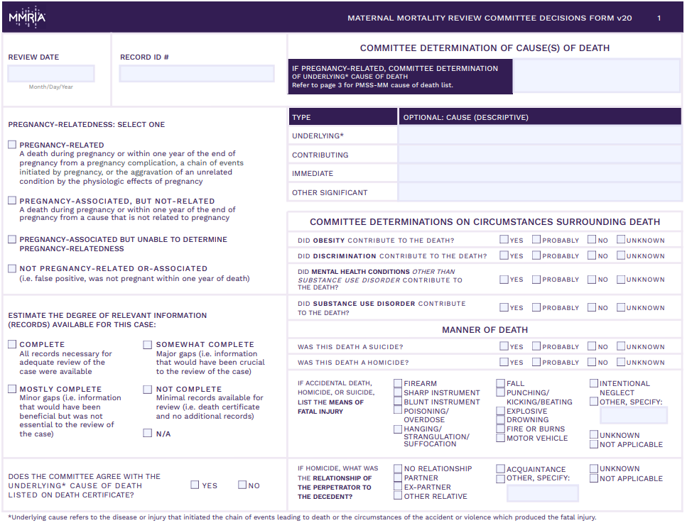
Page 1: Standardized MMRIA Committee Decisions Form
Sourced from: https://reviewtoaction.org/content/maternal-mortality-review-committee-decisions-form
Notes:
Instructions to program:
Introduce the committee decisions form to the committee.
Recommend having printing versions for each participant in the orientation session to review while slides cover the major points of the form.

Slide 33
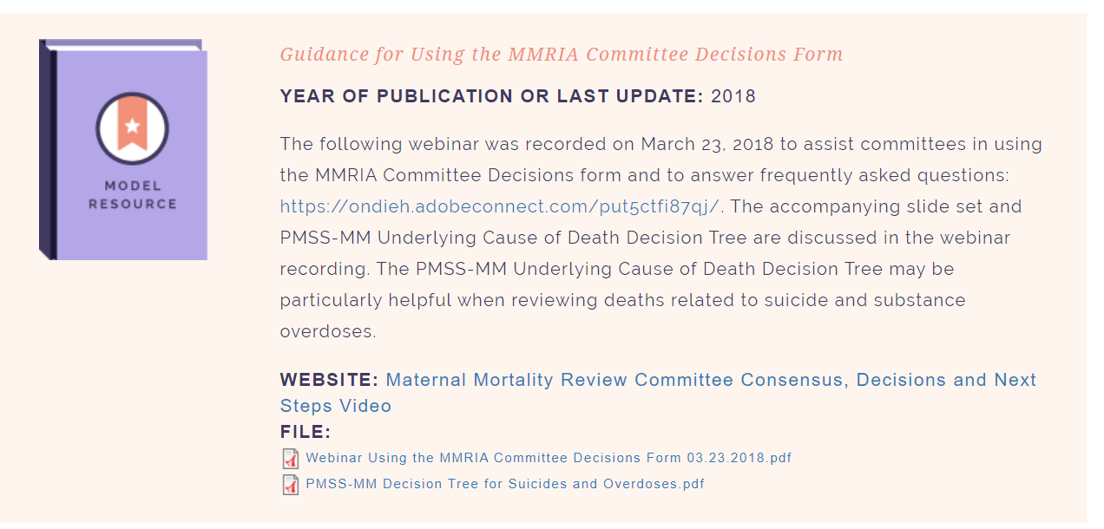
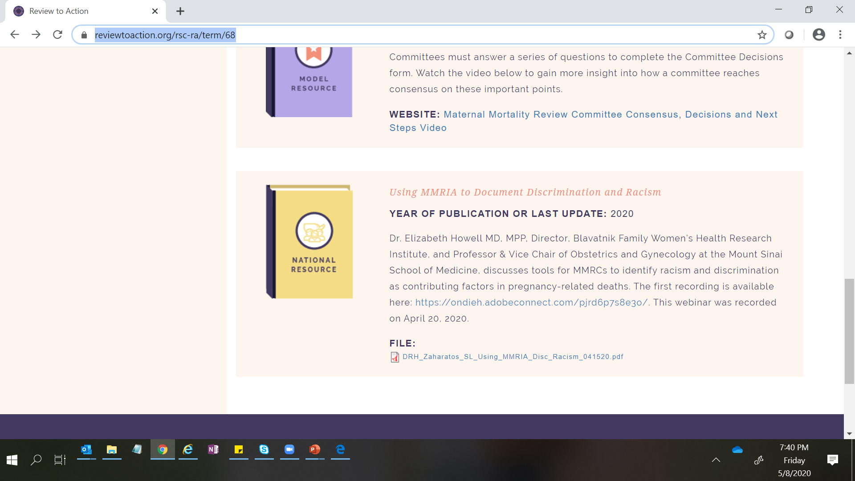
https://reviewtoaction.org/content/guidance-using-mmria-committee-decisions-form
Notes:
For a refresher on the basics of the form please visit the ReviewtoAction.org Resource Center and select Committee Decisions Form tools to review a primer webinar recording that was initially offered in March of 2018

Slide 34
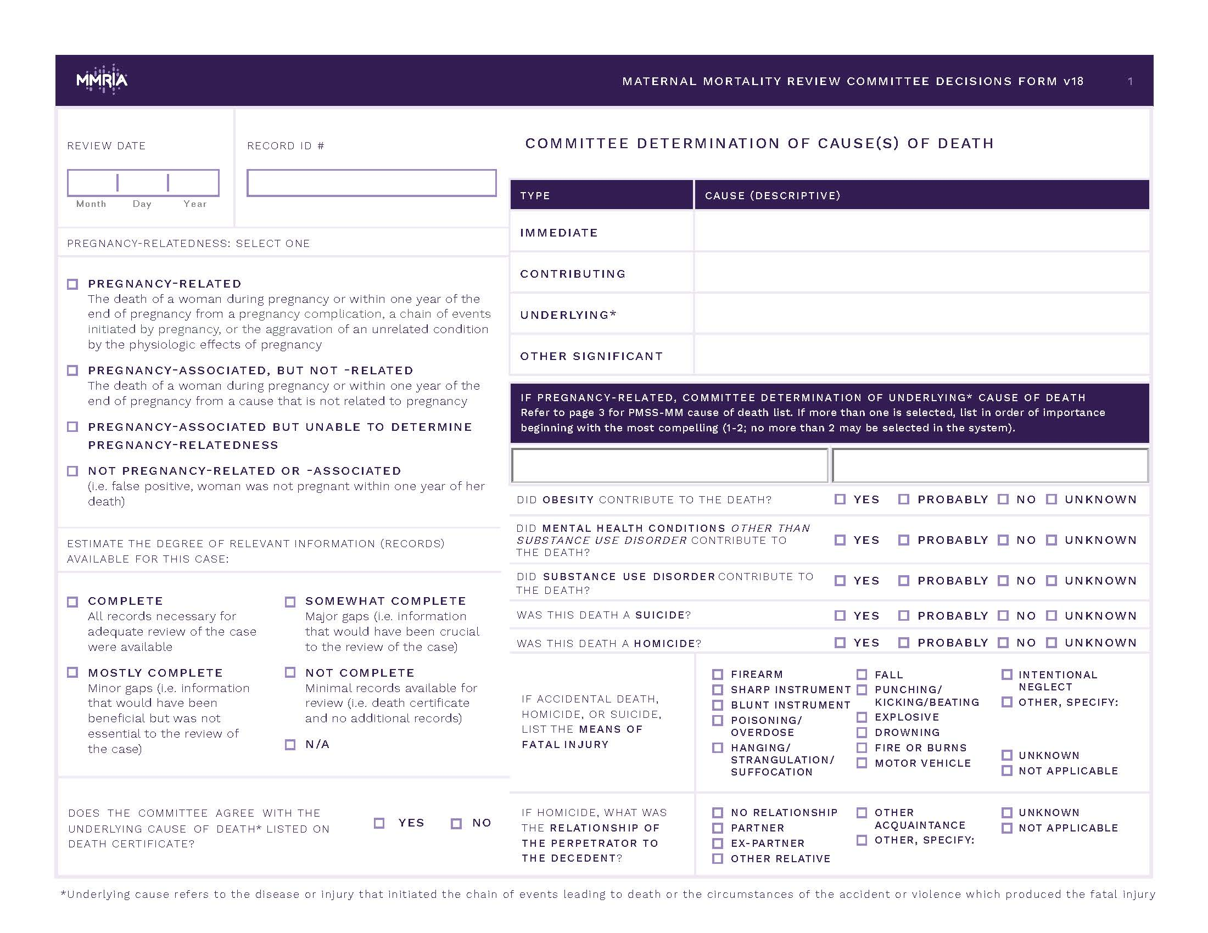
Review: Pregnancy-Related determination
If she had not been pregnant would she have died?
Pregnancy-related death:
The death of a woman while pregnant or within one year of the end of pregnancy from a pregnancy complication, a chain of events initiated by pregnancy, or the aggravation of an unrelated condition by the physiologic effects of pregnancy.
Notes:
Instructions to program:
Here, it is important to go over the definitions again and emphasize the differences. The role of the committee will be to determine which definition best matches each case reviewed after full review of the abstracted information.
Possible script for slide:
Pregnancy-related death: The death of a woman while pregnant or within one year of pregnancy from any cause related to or aggravated by the pregnancy or management, excluding accidental or incidental causes.
Pregnancy-associated, but not pregnancy-related death: The death of a woman while pregnant or within one year of pregnancy, due to a cause unrelated to pregnancy.
Pregnancy-associated death: The death of a woman while pregnant or anytime within one year of pregnancy regardless of cause.
Could not determine: The death of a woman while pregnant or within one year of pregnancy, due to a cause that could not be determined to be pregnancy-related or not pregnancy-related

Slide 35
Review: Completion of Records
Notes:
Instructions to program:
Show committee members bottom right-hand corner for CD form – explain this is where committee members can comment on the quality of records available for committee to review for the particular case in question. This data in the aggregate is a good quality measure for the program staff/abstractors.
Possible script for slide:
This is information in the committee decisions form allows us to consider whether we need better access to records. We use this data to communicate that to relevant stakeholders

Slide 36

Review: Agreement with Death Certificate on Cause of Death?
Committees often disagree with the underlying cause of death, in some cases 50 – 75% of the time.
Sourced from: https://reviewtoaction.org/content/maternal-mortality-review-committee-decisions-form
Notes:
Possible script for slide:
Here, we highlight the differences in committee findings vs. death certificate findings. With the level of information available to review committees they often disagree with the underlying cause of death that is listed on the death certificate.

Slide 37

Review: Cause of Death (PMSS-MM codes)
Underlying cause refers to the disease or injury that initiated the chain of events leading to death or the circumstances of the accident or violence which produced the fatal injury.
Notes:
Instructions to program:
Emphasize that this is the most important cause to capture accurately to identify your leading causes and prioritize opportunities for action
It is important to select one cause from the list of PMSS-MM codes on page 3 of the form. In extenuating circumstances there may be a second PMSS-MM code entered here.
Possible script for slide:
The underlying cause of death is the event that initiated the chain of events that ultimately led to the women’s death.

Slide 38
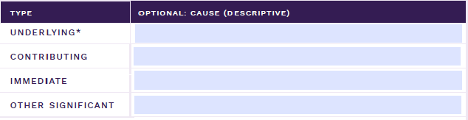
Review: Determination of Cause of Death (descriptive)
Notes:
Possible script for slide:
Here, the committee determines the immediate cause of death, contributing, the underlying cause of death, and documents any other significant conditions contributing to the death. These free text boxes are optional. They are often used by teams who want to document causes of pregnancy-associated, not related deaths.

Slide 39
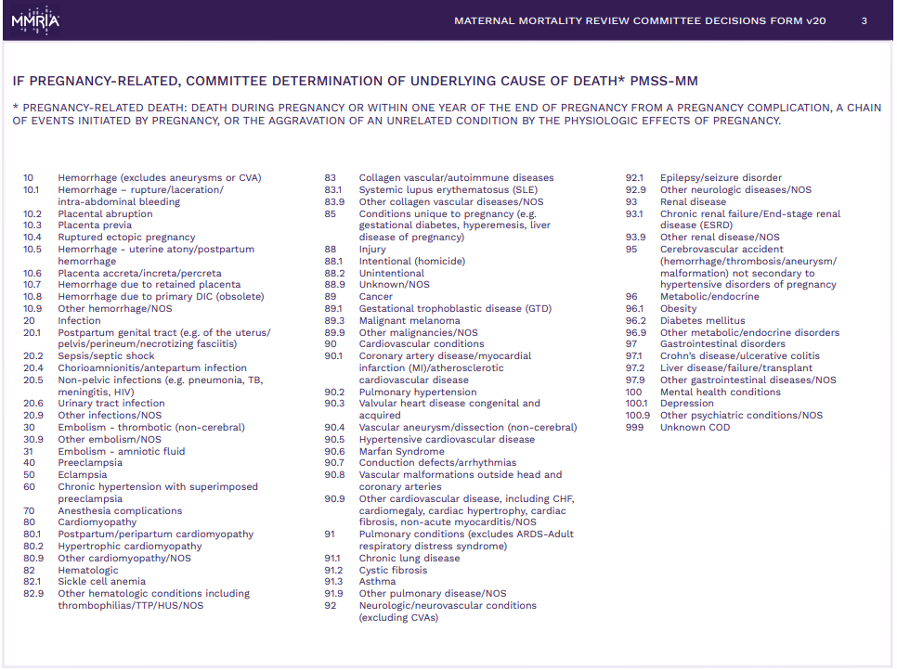
Page 3: PMSS-MM Codes for Reference
Sourced from: https://reviewtoaction.org/content/maternal-mortality-review-committee-decisions-form
Notes:
Instructions to program:
Show list of codes for quick reference is page 3 of the form.

Slide 40
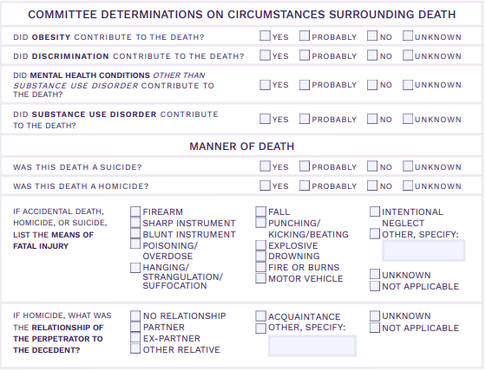
Review:
Committee Determinations on Circumstances Surrounding Death
Complete section for all pregnancy-associated deaths reviewed by your committee, regardless of relatedness.

Slide 41
Review:
Committee Determinations on Circumstances Surrounding Death
The checkboxes refer to the woman’s own experience, not the broader context surrounding her death.

Slide 42
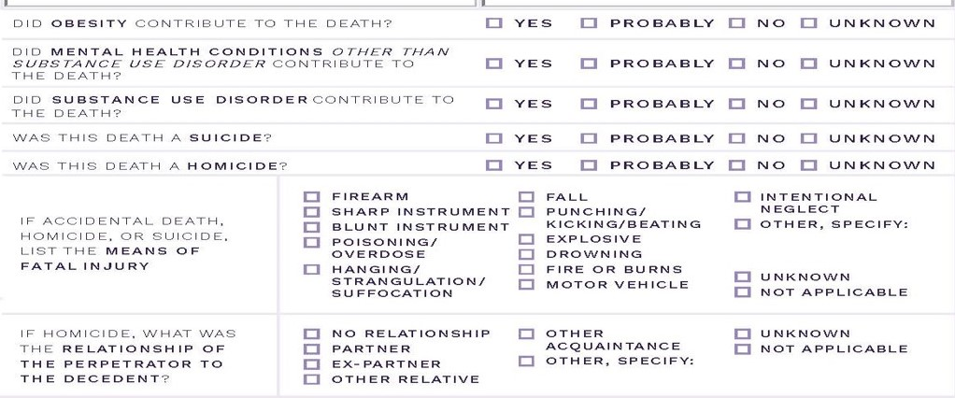
Review: Committee Determination on Obesity
This checkbox refers to obesity. It is intended to capture whether obesity contributed to the death, not whether the woman was obese / obesity was present.
Notes:
Instructions to program:
FAQs on the “checkboxes” Please note all FAQs below. Update slide as needed/based on your experiences with committee use of form to date.
1. Should the checkboxes be completed for all pregnancy-associated deaths or just those determined to be pregnancy-related?
The checkboxes should be completed for all pregnancy-associated deaths reviewed by your committee, regardless of relatedness. If your committee does not review a woman’s death because it is considered out of your scope, there is no need to complete the checkboxes.
2. Should the checkboxes be completed in reference to the woman, or the broader context surrounding her death?
The checkboxes refer to the woman’s own experience. For example, if a woman had a substance use disorder (see definition on page 4 of the MMRIA Committee Decisions Form) which contributed to her death, the checkbox should be marked ‘yes’. In contrast, if the death was a homicide where the perpetrator had a substance use disorder, but the woman did not, the checkbox should be marked ‘no’.
3. If substance use was involved in the death, should we choose ‘yes’ for the substance use disorder checkbox?
This checkbox refers to ‘substance use disorder’, not just substance use. The committee should only choose ‘yes’ or ‘probably’ if there is indication of a substance use disorder diagnosis or an expert on the committee (e.g. psychiatrist, psychologist, licensed counselor) who feels that the criteria for a diagnosis of substance use disorder are met based on the available information. In addition, the committee needs to decide that the substance use disorder was a contributing factor in the death.
4. Did discrimination contribute to the death?
Discrimination is treating someone less or more favorably based on the group, class or category they belong to resulting from biases, prejudices, and stereotyping. It can manifest as differences in care, clinical communication and shared decision-making.
5. For the substance use disorder and mental health conditions checkboxes, is a formal diagnosis required?
A diagnosis should ideally be indicated in the woman’s medical records. However, this may underestimate the number of women with substance use disorder or mental health conditions if women are unable to access care or treatment. Refer to your review committee subject matter experts (e.g. psychiatrist, psychologist, licensed counselor) to determine whether the criteria for a diagnosis of substance use disorder or another mental health condition are met based on the available information.
6. If substance use disorder contributed to the death, but another mental health condition did not, should we also choose ‘yes’ for the mental health conditions checkbox?
No, substance use disorder should be captured separately from other mental health conditions.
7. If certain deaths are not reviewed by our committee (for example, suicides and homicides), should we still complete the checkboxes?
No, these checkboxes are intended to the capture the committee decisions. If a death is not reviewed by the committee, the checkboxes should not be completed.
8. What if our determination for manner of death does not match the manner indicated on the death record?
The checkboxes are intended to capture the decisions of the review committee, and it is expected that sometimes these decisions may differ from the death record. For example, an overdose may have an unknown manner of death on the death certificate, but relevant subject matter experts (e.g. medical examiner), could review additional information and determine that the overdose was intentional. The committee would then check ‘yes’ for the suicide checkbox. There is also a question on the committee decisions form to indicate whether the committee agrees with the cause of death listed on the death certificate.
9. Are there opportunities for quality improvement with the checkbox data?
Yes, there are lots of opportunities using checkbox data. For example, all overdoses with indication of substance use disorder should have an underlying cause of death PMSS code of 100, 100.1, or 100.9 (Mental Health Conditions). If the substance use disorder checkbox is checked ‘yes’, but the PMSS code is 88.2 (Unintentional Injury), there may be discrepancies in how the PMSS code is being selected.
Another opportunity for quality improvement is to compare the obesity checkbox with the women’s actual BMI calculated using the height and weight provided in her records. Are there instances where your committee is selecting ‘yes’ when the BMI suggests she is at a healthy weight? Of note—this checkbox is intended to capture whether obesity contributed to the death, not whether the woman was obese / obesity was present.

Slide 43
Review: Committee Determination on Discrimination
This checkbox refers to discrimination. Discrimination is treating someone less or more favorably based on the group, class or category they belong to resulting from biases, prejudices, and stereotyping. It can manifest as differences in care, clinical communication and shared decision-making. (Smedley et al, 2003 and Dr. Rachel Hardeman)
Notes:
Instructions to program:
FAQs on the “checkboxes” Please note all FAQs below. Update slide as needed/based on your experiences with committee use of form to date.
1. Should the checkboxes be completed for all pregnancy-associated deaths or just those determined to be pregnancy-related?
The checkboxes should be completed for all pregnancy-associated deaths reviewed by your committee, regardless of relatedness. If your committee does not review a woman’s death because it is considered out of your scope, there is no need to complete the checkboxes.
2. Should the checkboxes be completed in reference to the woman, or the broader context surrounding her death?
The checkboxes refer to the woman’s own experience. For example, if a woman had a substance use disorder (see definition on page 4 of the MMRIA Committee Decisions Form) which contributed to her death, the checkbox should be marked ‘yes’. In contrast, if the death was a homicide where the perpetrator had a substance use disorder, but the woman did not, the checkbox should be marked ‘no’.
3. If substance use was involved in the death, should we choose ‘yes’ for the substance use disorder checkbox?
This checkbox refers to ‘substance use disorder’, not just substance use. The committee should only choose ‘yes’ or ‘probably’ if there is indication of a substance use disorder diagnosis or an expert on the committee (e.g. psychiatrist, psychologist, licensed counselor) who feels that the criteria for a diagnosis of substance use disorder are met based on the available information. In addition, the committee needs to decide that the substance use disorder was a contributing factor in the death.
4. Did discrimination contribute to the death?
Discrimination is treating someone less or more favorably based on the group, class or category they belong to resulting from biases, prejudices, and stereotyping. It can manifest as differences in care, clinical communication and shared decision-making.
5. For the substance use disorder and mental health conditions checkboxes, is a formal diagnosis required?
A diagnosis should ideally be indicated in the woman’s medical records. However, this may underestimate the number of women with substance use disorder or mental health conditions if women are unable to access care or treatment. Refer to your review committee subject matter experts (e.g. psychiatrist, psychologist, licensed counselor) to determine whether the criteria for a diagnosis of substance use disorder or another mental health condition are met based on the available information.
6. If substance use disorder contributed to the death, but another mental health condition did not, should we also choose ‘yes’ for the mental health conditions checkbox?
No, substance use disorder should be captured separately from other mental health conditions.
7. If certain deaths are not reviewed by our committee (for example, suicides and homicides), should we still complete the checkboxes?
No, these checkboxes are intended to the capture the committee decisions. If a death is not reviewed by the committee, the checkboxes should not be completed.
8. What if our determination for manner of death does not match the manner indicated on the death record?
The checkboxes are intended to capture the decisions of the review committee, and it is expected that sometimes these decisions may differ from the death record. For example, an overdose may have an unknown manner of death on the death certificate, but relevant subject matter experts (e.g. medical examiner), could review additional information and determine that the overdose was intentional. The committee would then check ‘yes’ for the suicide checkbox. There is also a question on the committee decisions form to indicate whether the committee agrees with the cause of death listed on the death certificate.
9. Are there opportunities for quality improvement with the checkbox data?
Yes, there are lots of opportunities using checkbox data. For example, all overdoses with indication of substance use disorder should have an underlying cause of death PMSS code of 100, 100.1, or 100.9 (Mental Health Conditions). If the substance use disorder checkbox is checked ‘yes’, but the PMSS code is 88.2 (Unintentional Injury), there may be discrepancies in how the PMSS code is being selected.
Another opportunity for quality improvement is to compare the obesity checkbox with the women’s actual BMI calculated using the height and weight provided in her records. Are there instances where your committee is selecting ‘yes’ when the BMI suggests she is at a healthy weight? Of note—this checkbox is intended to capture whether obesity contributed to the death, not whether the woman was obese / obesity was present.

Slide 44
https://reviewtoaction.org/content/using-mmria-document-discrimination-and-racism
Notes:
For a review of the new tools added to use MMRIA to document discrimination and racism please visit the ReviewtoAction.org Resource Center and select Committee Decisions Form tools to review the webinar recording offered in April.

Slide 45
Review:
Substance Use versus Substance Use Disorder (FAQ)
This checkbox refers to ‘substance use disorder’, not just substance use. The committee should only choose ‘yes’ or ‘probably’ if there is indication of a substance use disorder diagnosis or an expert on the committee (e.g. psychiatrist, psychologist, licensed counselor) who feels that the criteria for a diagnosis of substance use disorder are met based on the available information. If so, enter substance use disorder a contributing factor in the death on page 2 of the form.
Notes:
Instructions to program:
FAQs on the “checkboxes” Please note all FAQs below. Update slide as needed/based on your experiences with committee use of form to date.
Instructions to program:
FAQs on the “checkboxes” Please note all FAQs below. Update slide as needed/based on your experiences with committee use of form to date.
1. Should the checkboxes be completed for all pregnancy-associated deaths or just those determined to be pregnancy-related?
The checkboxes should be completed for all pregnancy-associated deaths reviewed by your committee, regardless of relatedness. If your committee does not review a woman’s death because it is considered out of your scope, there is no need to complete the checkboxes.
2. Should the checkboxes be completed in reference to the woman, or the broader context surrounding her death?
The checkboxes refer to the woman’s own experience. For example, if a woman had a substance use disorder (see definition on page 4 of the MMRIA Committee Decisions Form) which contributed to her death, the checkbox should be marked ‘yes’. In contrast, if the death was a homicide where the perpetrator had a substance use disorder, but the woman did not, the checkbox should be marked ‘no’.
3. If substance use was involved in the death, should we choose ‘yes’ for the substance use disorder checkbox?
This checkbox refers to ‘substance use disorder’, not just substance use. The committee should only choose ‘yes’ or ‘probably’ if there is indication of a substance use disorder diagnosis or an expert on the committee (e.g. psychiatrist, psychologist, licensed counselor) who feels that the criteria for a diagnosis of substance use disorder are met based on the available information. In addition, the committee needs to decide that the substance use disorder was a contributing factor in the death.
4. Did discrimination contribute to the death?
Discrimination is treating someone less or more favorably based on the group, class or category they belong to resulting from biases, prejudices, and stereotyping. It can manifest as differences in care, clinical communication and shared decision-making.
5. For the substance use disorder and mental health conditions checkboxes, is a formal diagnosis required?
A diagnosis should ideally be indicated in the woman’s medical records. However, this may underestimate the number of women with substance use disorder or mental health conditions if women are unable to access care or treatment. Refer to your review committee subject matter experts (e.g. psychiatrist, psychologist, licensed counselor) to determine whether the criteria for a diagnosis of substance use disorder or another mental health condition are met based on the available information.
6. If substance use disorder contributed to the death, but another mental health condition did not, should we also choose ‘yes’ for the mental health conditions checkbox?
No, substance use disorder should be captured separately from other mental health conditions.
7. If certain deaths are not reviewed by our committee (for example, suicides and homicides), should we still complete the checkboxes?
No, these checkboxes are intended to the capture the committee decisions. If a death is not reviewed by the committee, the checkboxes should not be completed.
8. What if our determination for manner of death does not match the manner indicated on the death record?
The checkboxes are intended to capture the decisions of the review committee, and it is expected that sometimes these decisions may differ from the death record. For example, an overdose may have an unknown manner of death on the death certificate, but relevant subject matter experts (e.g. medical examiner), could review additional information and determine that the overdose was intentional. The committee would then check ‘yes’ for the suicide checkbox. There is also a question on the committee decisions form to indicate whether the committee agrees with the cause of death listed on the death certificate.
9. Are there opportunities for quality improvement with the checkbox data?
Yes, there are lots of opportunities using checkbox data. For example, all overdoses with indication of substance use disorder should have an underlying cause of death PMSS code of 100, 100.1, or 100.9 (Mental Health Conditions). If the substance use disorder checkbox is checked ‘yes’, but the PMSS code is 88.2 (Unintentional Injury), there may be discrepancies in how the PMSS code is being selected.
Another opportunity for quality improvement is to compare the obesity checkbox with the women’s actual BMI calculated using the height and weight provided in her records. Are there instances where your committee is selecting ‘yes’ when the BMI suggests she is at a healthy weight? Of note—this checkbox is intended to capture whether obesity contributed to the death, not whether the woman was obese / obesity was present.

Slide 46
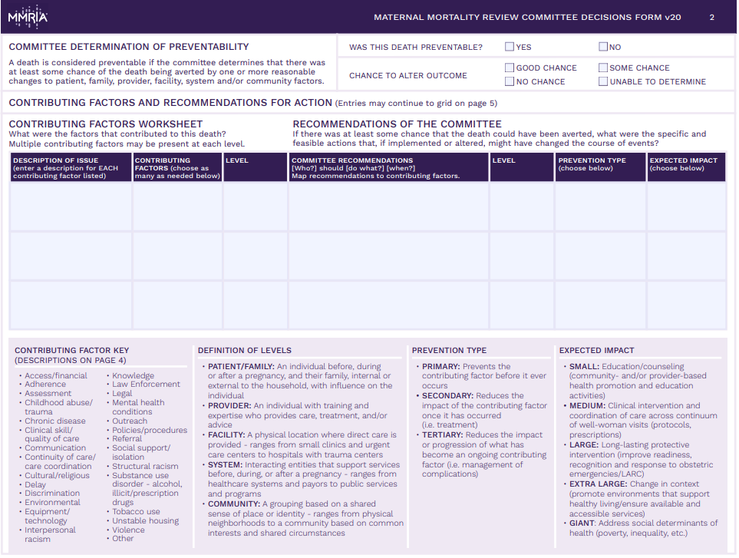
Page 2: Standardized Committee Decisions Form
Sourced from: https://reviewtoaction.org/content/maternal-mortality-review-committee-decisions-form

Slide 47
Preventability
Preventability
A death is considered preventable if the committee determines that there was at least some chance of the death being averted by one or more reasonable changes to patient, family, provider, facility, system and/or community factors.
Sourced from: Berg CJ, Harper MA, Atkinson SM, Bell EA, Brown HL, Hage ML, et al. Preventability of pregnancy-related deaths: results of a state-wide review. Obstet Gynecol 2005;106:1228–34. and https://reviewtoaction.org/content/maternal-mortality-review-committee-decisions-form
Notes:
Possible script for slide:
Why determine preventability?
Preventability provides a framework of prioritization for recommendations.
Why do preventability estimates vary between MMRCs?
Preventability determinations are often a reflection of MMRC composition. Multidisciplinary MMRCs have a greater understanding of opportunities to prevent deaths.
What should our committee do if we get stuck on the preventability question?
It may be helpful to first discuss the factors that contributed to the death, and recommendations to address those contributing factors.
How can we avoid speculation in the case of inadequate or incomplete case information?
Inadequate information can make any case determination difficult. It’s important not to resort to speculation, stay on task, admit that you don’t know what you don’t know about the case and the Chair may direct the committee to move on.
How can we help the media and the public broaden the focus on preventability, particularly beyond the provider/facility level?
Addressing medical factors alone will not get us to the reductions we want to achieve. In order to broaden this perspective committees must document factors and recommendations at all levels (Patient/Family, Provider, Facility, System and Community). Multidisciplinary review promotes understanding of patient-, community-, and system-level factors as well as development of actionable recommendation at all levels.
How can we craft recommendations that are useful to abstractors, analysts and for reporting to stakeholders and the public?
An actionable recommendation is mapped to a contributing factor and is structured as follows: [Who] should [do what], [when/where?] A diversity of voices at the table provide greater perspective on system-level factors that may influence factors such as late entry into prenatal care

Slide 48
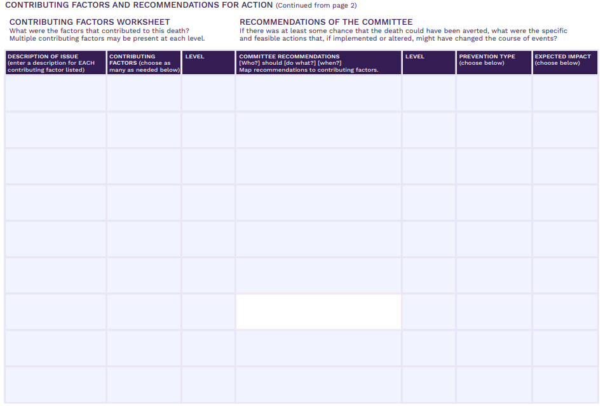
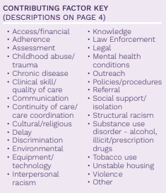
Contributing Factors
Notes:
Instructions to program:
Discuss how the form allows space for each contributing factor listed to be mapped to a recommendation for action.

Slide 49

Contributing Factors
Notes:
Instructions to program:
Remember to fill out this description – this is where you can explain the circumstances in a woman’s life that contributed to her death. Leaving this blank will make it difficult to impossible for your analysts and report-writers to interpret the contributing factor class that was entered.

Slide 50
Recommendations for Action
Notes:
Map contributing factors to recommendations for action

Slide 51
Specific and Actionable Recommendations
______ should _________ ________.
(who?) (do what?) (when?)
WHO is the entity/agency who would have been/be responsible for the intervention?* | WHAT is the intervention and WHERE is the intervention point?* Patient/Family Provider Facility System Community | WHEN is the proposed intervention point? Among women of reproductive age (“preconception”) In pregnancy and in the postpartum period Labor & Delivery (L&D) Prior to L&D hospitalization discharge First 6 weeks postpartum 42-365 days postpartum
*Enter recommendation at the relevant level (Patient/Family, Provider, Facility, System, Community).
Sourced from: MMRIA Facilitation Guide, https://reviewtoaction.org/content/committee-facilitation-guide

Slide 52
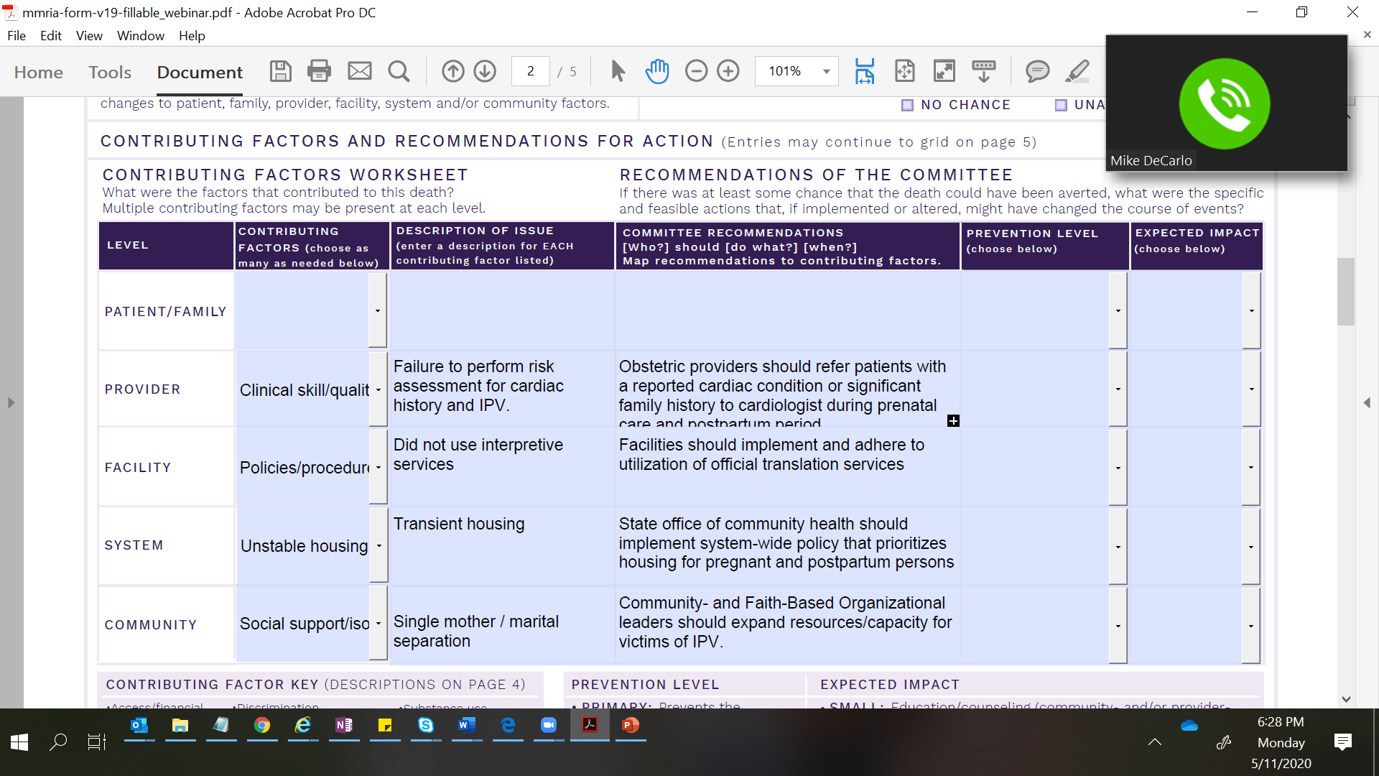
Map Contributing Factors to Recommendations for Action
MMRIA committee decisions form (https://reviewtoaction.org/content/maternal-mortality-review-committee-decisions-form)
Notes:
Recommendations for action are some of the most difficult items to devise on the spot. This is where it’s important to share Case Narratives in advance of meetings so that members have time to prepare.
Map each contributing factor with description to an actionable recommendation, as shown here.
We consciously chose not to include patient/family level recommendations in the example shown here because most recommendations will be focusing resources according to opportunity to prevent the contributing factor.

Slide 53
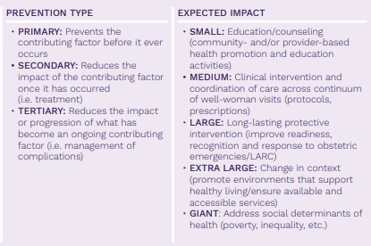
Recommendations for Action
Notes:
Instructions to program:
Explain the fields for level of prevention and level of impact, helps you prioritize the recommendations. Discuss how your review committee handles this part of form (e.g. due to time constraints some committees may have staff complete after the committee review, it is not a full committee task to complete for every case reviewed).

Slide 54
MMRIA Overview
<insert MMRIA jurisdiction page link here>

Slide 55
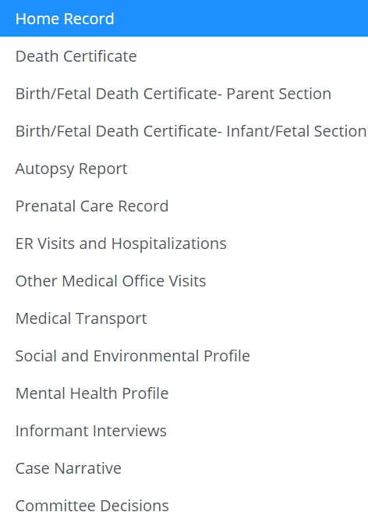
MMRIA OVERVIEW
MMRIA is a data management system designed to house data necessary for facilitating comprehensive maternal mortality review.
MMRIA’s 13 Abstraction Forms + 1 Committee Decisions Form help MMRC members understand the story of a woman’s life, and the events leading to her death.

Slide 56
PURPOSE
Primary purpose is to serve as a repository of medical and non-clinical information needed for Maternal Mortality Review Committee case review.
Secondary purpose is to standardize maternal mortality data collection, so that it can be used for surveillance, monitoring, and research.
MMRIA serves as a one-stop shop for Abstracted and Committee decision data.
Notes:
Possible script for slide:
MMRIA’s primary purpose is to serve as a repository of abstracted information needed for conducting Maternal Mortality Case Reviews by MMRCs.
2) A secondary purpose of MMRIA is to standardize maternal mortality data collection, so it can be used in:
- Jurisdiction-based and national surveillance, AND
- For developing evidence-based process or policy recommendations, to reduce or prevent maternal mortality.

Slide 57
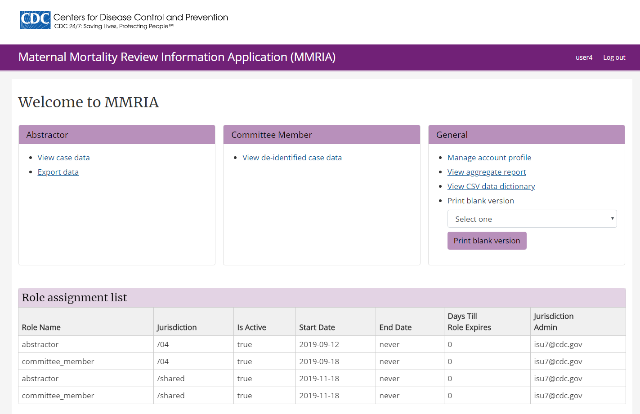
Notes:
Instructions to program:
This slide shows the MMRIA home page.
If your program intends to give committee members access to MMRIA via the Committee Member role, you may want to do more direct orientation of your MMRIA site.

Slide 58
MMRC Structure and Member Responsibilities
(enter corresponding slides, as appropriate, to explain your specific committee member responsibilities and structure)

Slide 59
<state> Committee Structure
Representation
  The Committee is comprised of a multidisciplinary team including representatives from rural and urban midwifery, family medicine, nursing, forensic pathology, psychology and psychiatry, anesthesiology, maternal-fetal medicine, and obstetrics and gynecology; doula services and patient advocacy; social work; health systems; state and local public health and epidemiology; addiction treatment; home visiting; and violence prevention. <or edit>
Appointment
  Committee members are selected via competitive application and appointed by the Department <or edit>
Term limits
  MMRC members serve three-year terms and may serve up to three terms <or edit>
Sourced from: MMRIA Facilitation Guide, https://reviewtoaction.org/content/committee-facilitation-guide
Notes:
Instructions to program:
Update text on slide as relevant

Slide 60
<state> Committee Roles
Chair<or edit>
  Participates in process to prioritize cases for review
  Facilitates discussion, engaging all members in committee decisions
  Engages support staff to ensure complete committee decisions
  Reviews case narratives for completion prior to committee meeting
Coordinator <or edit>
  Participates in process to prioritize cases for review
  Ensures key committee documents are updated, meetings are scheduled, members invited, agendas drafted, members receive narratives in advance of meeting, multiple notetakers are assigned to record decisions made during meetings, and combines notes into one version that is entered into MMRIA. May coordinate activities to implement findings from review deliberations.
Abstractor(s)
  Participates in process to prioritize cases for review
  Abstracts cases and maintains regular communication with coordinator to review the status of a case abstraction
Epidemiologist(s)
  May assist in case identification process
  Provides data analysis support for developing products from the reviews
  Provides data quality checks of MMRIA data and during the deliberation process.
  May assist in abstracting vital records and entering final committee decisions in MMRIA
Sourced from: MMRIA Facilitation Guide, https://reviewtoaction.org/content/committee-facilitation-guide
Notes:
Instructions to program:
Update text on slide as relevant – consider introducing/providing contact information for key staff here

Slide 61
<state> Committee Facilitation Roles
The ability of committee members to interact and relate with each other is a key factor in determining how successful they will be in accomplishing their goals and reaching their vision.
A cohesive environment should not prevent diversity of thought or opinion but rather help the committee avoid losing sight of its scope, mission, scope, and vision.
Sourced from: MMRIA Facilitation Guide, https://reviewtoaction.org/content/committee-facilitation-guide
Notes:
Instructions to program:
Update text on slide as relevant. Purpose of slide is to touch on importance of group dynamics. Further information on group dynamics is also included MMRIA Facilitation Guide (citation on slide).

Slide 62

Self-care <or edit>
“The expectation that we can be immersed in trauma and not be affected is like walking through water and not getting wet.” Ifetayo White
Sourced from MMRIA User Meeting IV, Atlanta, December 2019
Notes:
Instructions to program:
Emphasize the importance of self care, especially after each committee meeting

Slide 63
Caring Begins With You
We will take a moment of silence at the opening and closing of each review to center ourselves in the work that lies ahead.
Reviewing maternal deaths can be physically, mentally, and emotionally exhausting.
Remember that the weight of this work does not rest on any one person’s shoulders. We are part of a greater network striving to save the lives of mothers and improve the lives of women.
Sourced from: MMRIA Facilitation Guide, https://reviewtoaction.org/content/committee-facilitation-guide

Slide 64
MMRC Timeline/Next Steps
(enter corresponding slides, as appropriate)

Slide 65
Questions?

